Slide 1
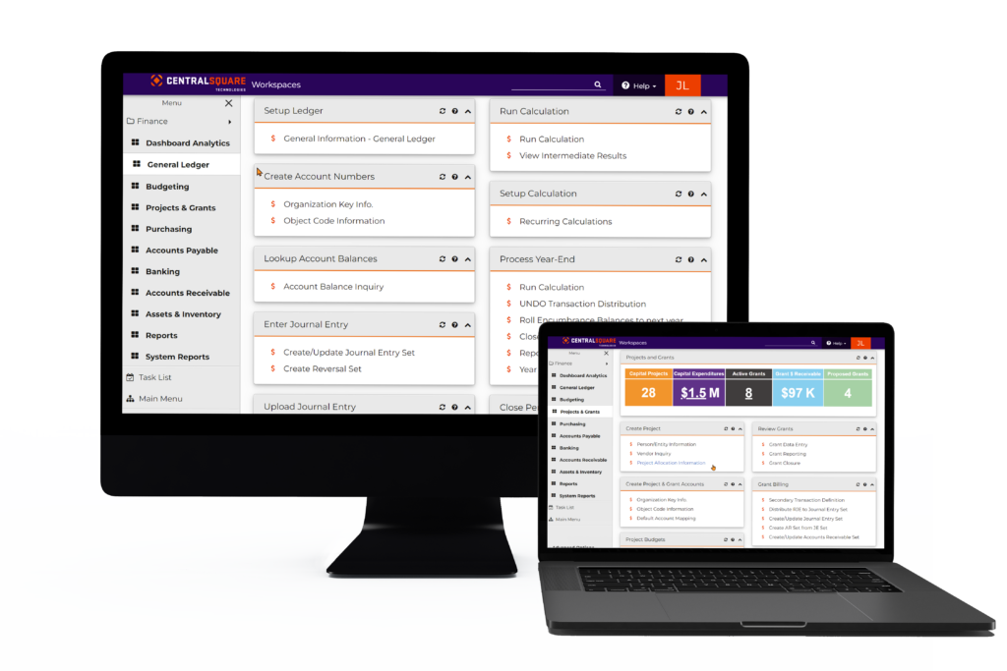
FINANCE ENTERPRISE™ LUNCH & LEARN

Slide 2
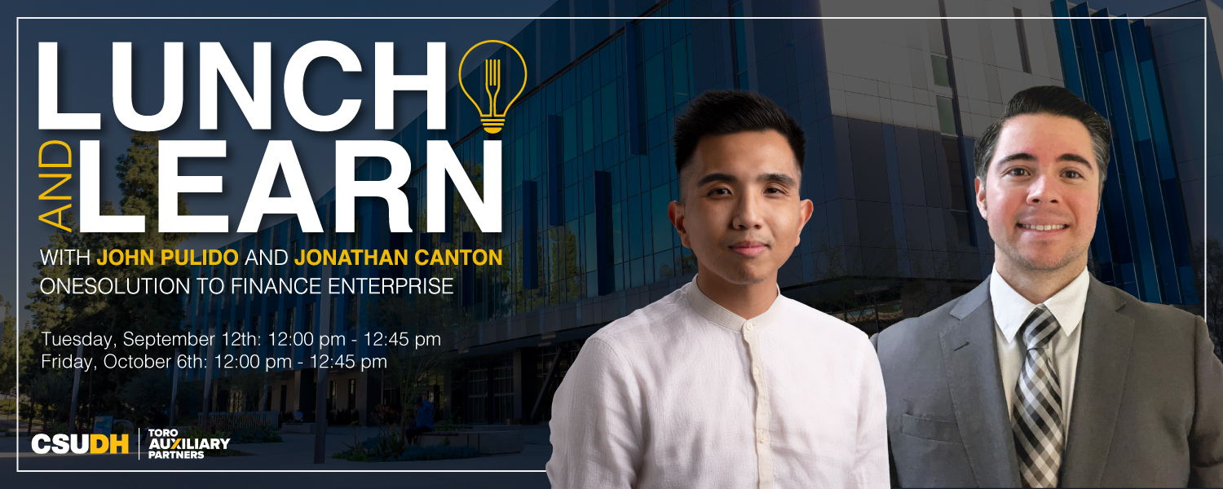
FINANCE ENTERPRISE™ LUNCH & LEARN

Slide 3
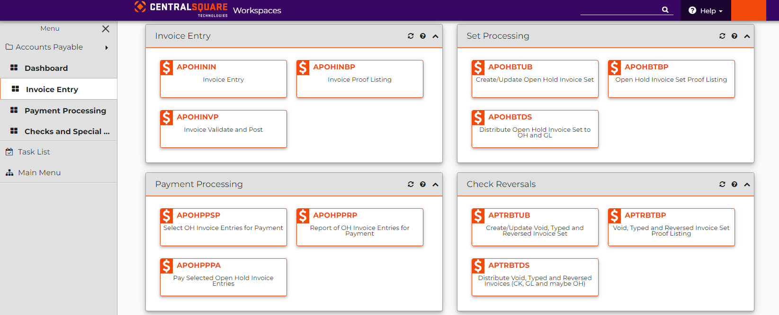
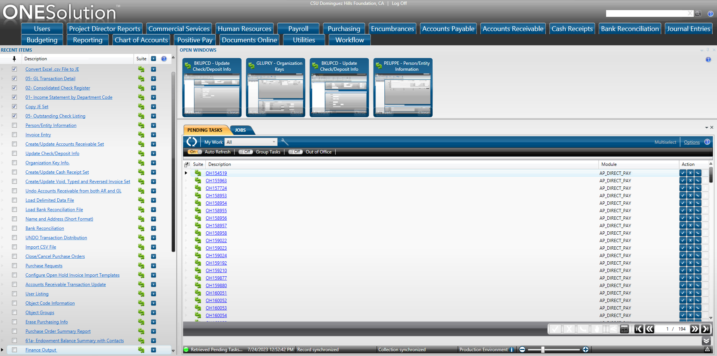

Overview
The Toro Auxiliary Partners are excited to announce our newest upgrade to our Enterprise Resource Planning system (ONESolution) to Finance Enterprise.

Slide 4
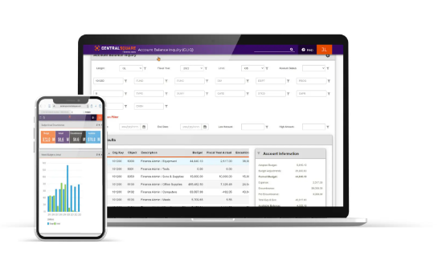
Key Benefits
Configurability and Scalability: Finance Enterprise is designed to be configurable to accommodate the specific needs and processes of different organizations. It can scale as an organization grows or undergoes changes, allowing for flexibility and adaptability.
Support and Customer Service: CentralSquare provides ongoing support and customer service to assist organizations in utilizing Finance Enterprise effectively. This includes training, technical assistance, and updates to ensure the software meets evolving requirements.

Slide 5
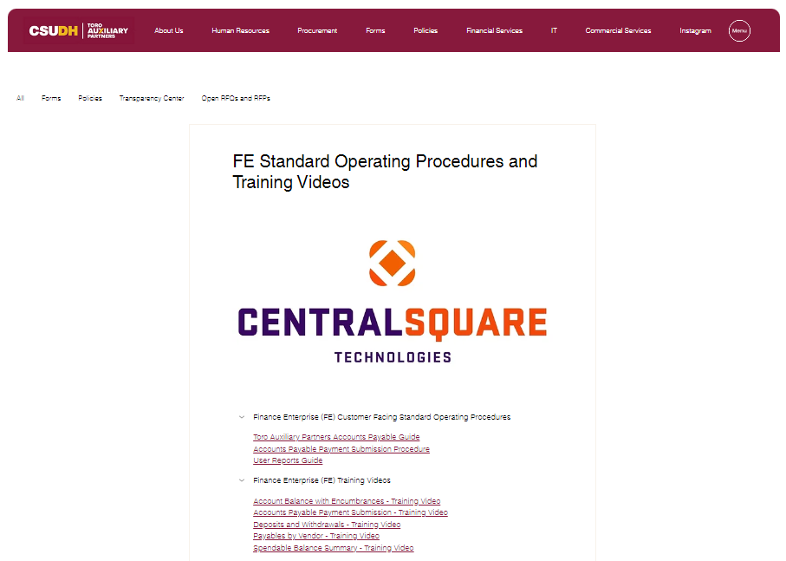
Tutorials & Instructional Materials
Currently, help guides are located within Finance Enterprise for user assistance. In addition, we also have training videos and SOPs located within TAP’s Finance Enterprise webpage.

Slide 6
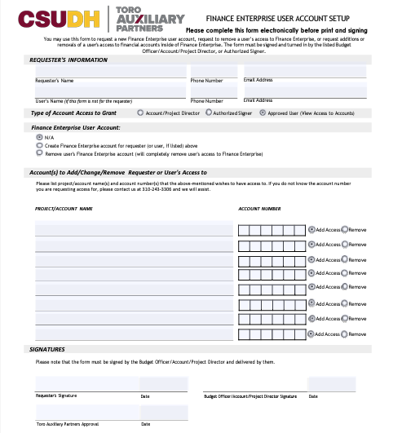
Finance User Account Form
Finance User Account Form

Slide 7

Finance Enterprise Login Instructions

Slide 8


Installing Global Protect VPN
If you haven’t already set up VPN access, do the following. Otherwise, skip this page.
In order to access Finance Enterprise, you must be connected to the VPN (virtual private network)
Set that up by doing the following:
• Setup MFA DUO, which is required for many CSUDH apps including the VPN
• Install and login to Global Protect VPN

Slide 9
Login Screen
If you do not currently have credentials to the prior ERP system ONESolution, stop here and submit the User Setup Form to Jonathan Canton Jcanton@csudh.edu and Jacob Hernandez jachernandez@csudh.edu
Ensure you are connected to the Global Protect VPN
Click this link to access the Finance Enterprise environment. Please feel free to bookmark in your browser.
Please use your existing ONESolution credentials to access Finance Enterprise.
U: dhillcld\******
P: **********

Slide 10
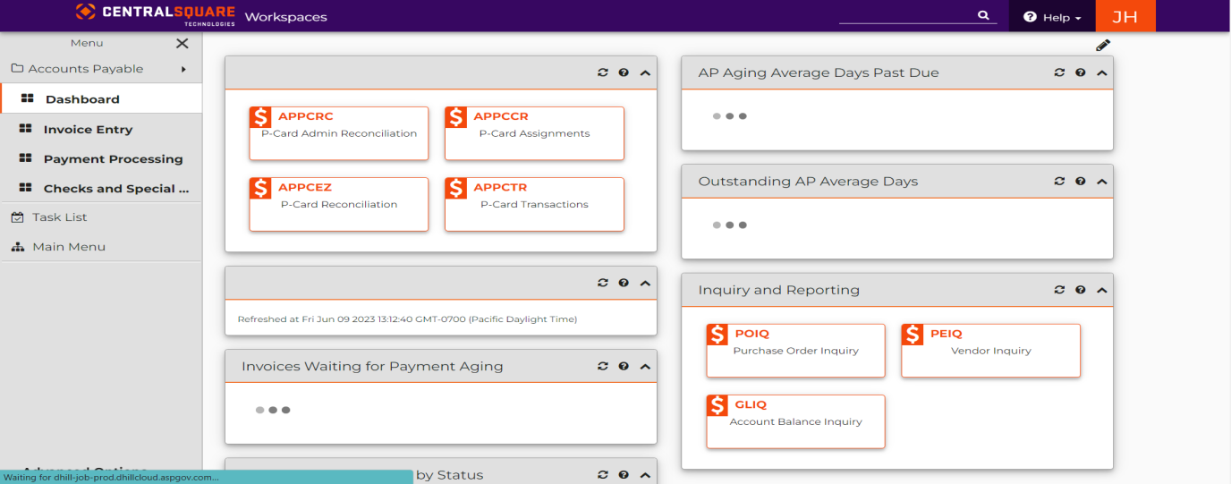
Dashboard
You will then be taken to your fully customizable Workspaces page where you can access all the same modules that were available in ONESolution.

Slide 11
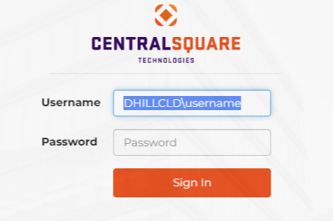
Login/Testing Information:
Login to Finance Enterprise with your existing ONESolution login credentials.

Slide 12
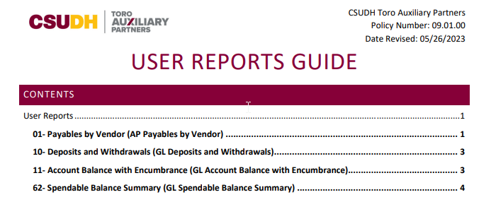
User Reports Guide
Notes:
I PROMISE WE’LL HAVE A QUESTION & ANSWER PORTION AT THE END, SO IF YOU HAVE ANY QUESTIONS RELATING TO ITEMS OUTSIDE OF THE ONES BEING PRESENTED, PLEASE FEEL FREE TO HOLD THEM UNTIL THEN
ALL REPORTS FROM ONESOLUTION WILL BE PORTED OVER. MEANING THEY WILL FUNCTION ESSENTIALLY THE SAME. THEY HAVE JUST RECEIVED A MINOR FACELIFT AND ARE NOW ACCESSIBLE VIA WEB BROWSER.
COMMONLY USED REPORTS. LIVE DOCUMENT. ANY REQUESTS THAT RECEIVE POPULAR DEMAND WILL BE ADDED TO THE GUIDE.
CLICK ON GUIDE USED FOR SLIDE 14.

Slide 13
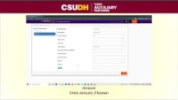
Reporting: Payables by Vendor Report
Notes:
ONE OF TWO WAYS. FOR THE REPORTS ON THE PREVIOUS SLIDE, WE HAVE CREATED VIDEO TUTORIALS AS WELL.
WAY NUMBER ONE: PLAY VIDEO

Slide 14
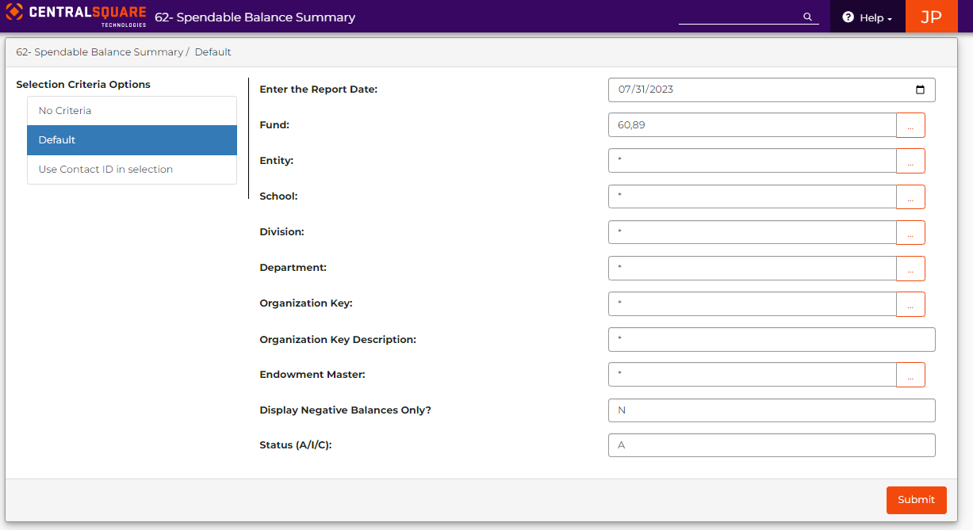
Live Demo: Spendable Balance Summary Report
Notes:
STEP BY STEP COMPARISON WITH THE USER REPORTS GUIDE
ARTS AND HUMANITIES, ARTS AND DESIGN EXAMPLE
LASTLY, EXPORT TO PDF OR TO EXCEL

Slide 15


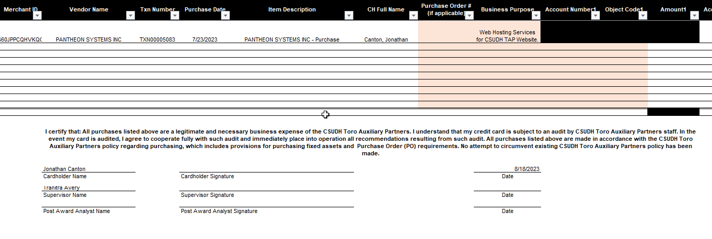
Improved P-Card Reconciliation
Notes:
BITMOJI DISCLAIMER
FOR ANY OF MY CARDHOLDERS ON THE CALL, THANK YOU SO MUCH FOR YOUR PATIENCE WITH THE MANUAL PROCESS THAT YOU HAVE ENDURED FOR THE PAST ----YEAR.
WHAT THE P-CARD RECON PROCESS WILL BE IN FE IS ALWAYS HOW WE ENVISIONED IT; HOWEVER, FULL TRANSPARENCY, THERE WERE TECHNICAL DIFFICULTIES THAT OCCURRED WITH ONESOLUTION THAT MADE US UNABLE TO PROVIDE THAT P-CARD RECON.
GREAT NEWS IS THAT…

Slide 16
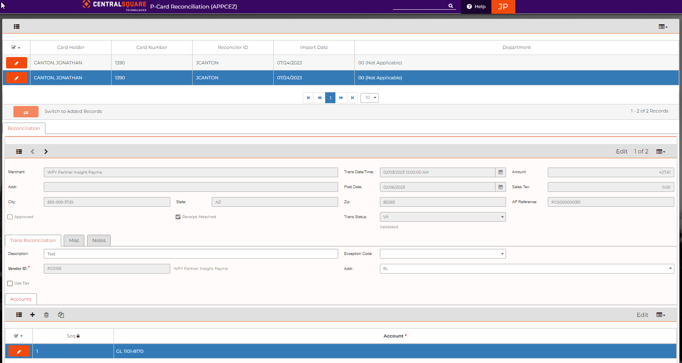
Improved P-Card Reconciliation

Slide 17

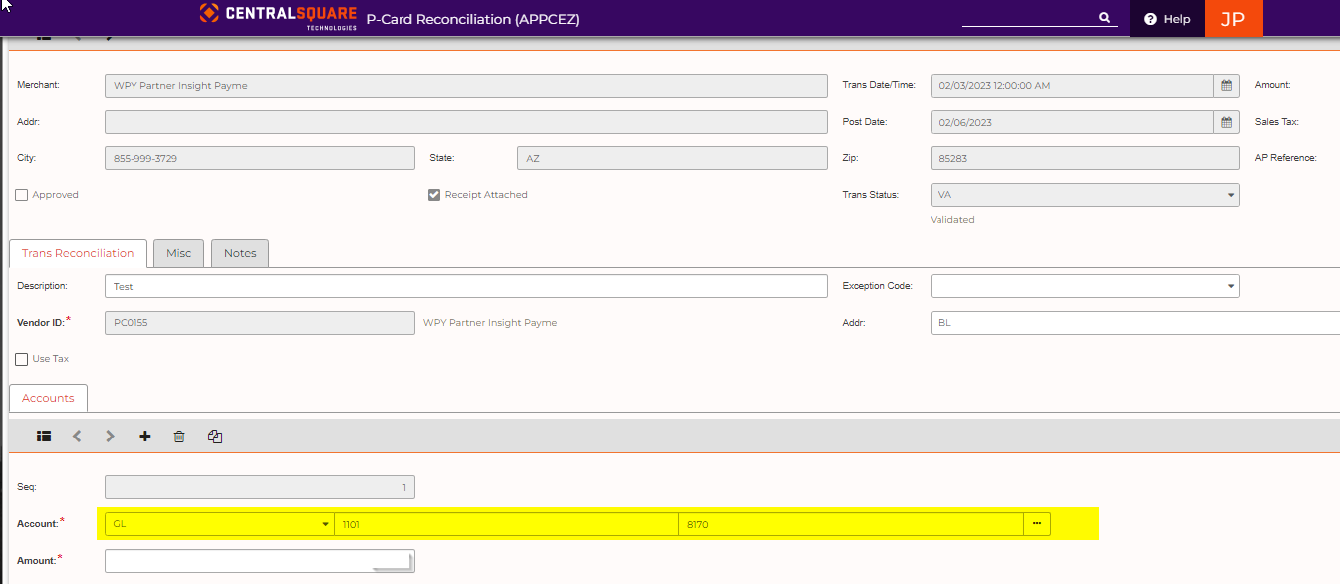
Reconciling now as easy as 1, 2, 3!
1. Add account and object code for each record.
Notes:
NO MORE THIS NO MORE THAT
THE STATEMENT WILL BE UPLOADED FOR YOU EVERY TWO WEEKS, WHEN THEY BECOME AVAILABLE FROM THE BANK OF AMERICA PORTAL
ALL YOU WILL HAVE TO DO IS RECONCILE EACH TRANSACTION IN 3 EASY STEPS.

Slide 18
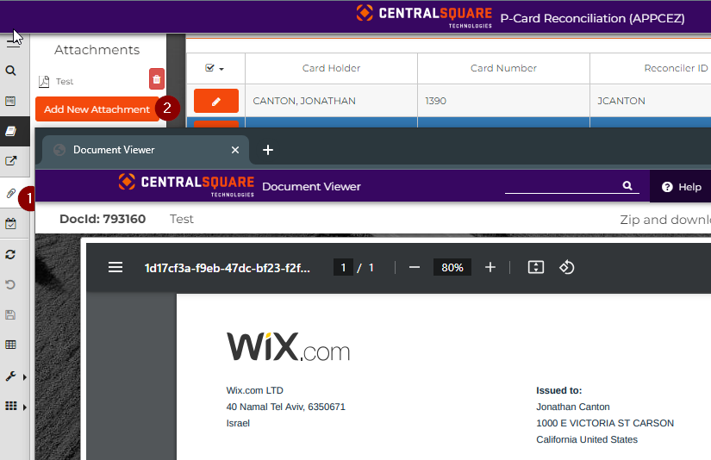
Reconciling now as easy as 1, 2, 3!
1. Add account and object code for each record.
2. Add attachments.

Slide 19
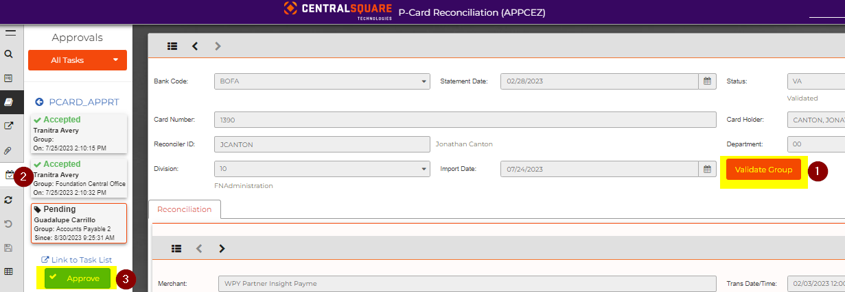
Reconciling now as easy as 1, 2, 3!
1. Add account and object code for each record.
2. Add attachments.
3. Validate and approve!
Training video coming soon!

Slide 20

Tentative Date
We are currently in the final phase of our ONESolution to Finance Enterprise migration.
A revised go-live date of September 18th would better accommodate the CSUDH faculty and staff.
Starting September 18th , all current ONESolution users will begin using Finance Enterprise.

Slide 21

P-Card Go Live Date
Starting October 2nd, P-Card reconciliation process will take place entirely on Finance Enterprise.

Slide 22
Tutorials & Instructional Materials
Currently, help guides are located within Finance Enterprise for user assistance. In addition, we also have training videos and SOPs located within TAP’s Finance Enterprise webpage.

Slide 23
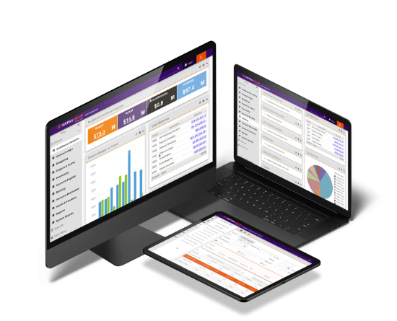
Questions?
If account setup is needed, please submit User Account Setup to Jacob Hernandez (jachernandez@csudh.edu).
For questions regarding the form, please reach out to John Pulido (jpulido5@csudh.edu).
For additional questions about Finance Enterprise, send us an email at AuxiliaryPartners.HelpDesk@csudh.edu.

Slide 24

Save the Date!
We have our next Finance Enterprise Lunch & Learn on Friday, October 6th: 12:00 pm – 12:45 pm
Register now!

Slide 25


GAME TIME!
Rules:
Two questions.
Please answer IN THE CHAT.
Prize:
$5 Amazon Gift Card sent to your email

Slide 26
Question #1
What is the name of the report used to see the payment history for a particular vendor?

Slide 27
Question #2
The new P-Card reconciliation process is as easy as 1, 2, 3! What is the second step in P-Card reconciliation process?

